Slide 1
NCA Sponsored Training
Day 2 – Afternoon Session (Lab)
Practical Introduction to Public Key Encryption
Presenter Name: Dr. Danish Vasan
City: Dhahran
16 February 2025
Notes:
Some of the material used in this presentation has been adapted and remixed from course materials from the Virginia Tech University and Purdue University

Slide 2
Outline
How to encrypt files with RSA and OpenSSL
RSA by Hand
OpenSSL(RSA)
OpenSSL(ECC)
Digital Certificates and Signature
Examining details of a Certificate
Root Certificate Authorities
OpenSSL Demo
Complete communication protocol using asymmetric crypto

Slide 3
Asymmetric Cryptography
The key objective of this lab is to provide a practical introduction to public key encryption, with a focus on RSA and Elliptic Curve methods. This includes the creation of key pairs and in the signing process.
In the second part, we will explore Digital Certificates

Slide 4
RSA by Hand
Encryption:
Let M = 15
C = Me mod n
C = ?
Decryption:
Let C = 62
M = C^{d} mod n
M = ?
Calculate n: n=p×q, where p=13, q=5
Calculate Euler’s Totient Function φ(n) φ(n) = (p - 1)(q - 1)
Choose e: between 1 and φ(n) with no common divisors between e and φ(n) Possible values for e: (A) 5 (B) 2 (C) 3
Choose d: between 1 and φ(n) s.t. e*d mod φ(n) = 1

Slide 5
How to encrypt files with OpenSSL
Get Started:
Open a Linux terminal (Kali-linux Virtual Machine)
Check if you have OpenSSL installed, and what version do you have:
$ openssl version
Generate a key pair with the following command
$ openssl genrsa -out private.pem 1024

Slide 6
How to encrypt files with OpenSSL
Open the key:
The file private.pem contains both the public and the private key.
Open the file with the following command:
$ cat private.pem
You can see the key’s details with the following command
$ openssl rsa -in private.pem -noout -text

Slide 7
How to encrypt files with OpenSSL
Secure the key:
Let’s now secure the encrypted key with 3-DES:
$ openssl rsa -in private.pem -des3 -out key3des.pem
Why should you have a password on the usage of your private key?

Slide 8
How to encrypt files with OpenSSL
Export the public key:
You can export the public key from the private one with the following command:
$ openssl rsa -in private.pem -out public.pem -outform PEM –pubout
You can see the key’s details with the following command
$ openssl rsa -in public.pem -pubin -text

Slide 9
How to encrypt files with OpenSSL
Encrypt and Decrypt a file:
Create a file named “myfile.txt” and put a message into it.
Encrypt your file with your public key:
$ openssl pkeyutl -encrypt -inkey public.pem -pubin -in myfile.txt -out top_secret.enc
Try to open the encrypted file
$ cat top_secret.enc
Notes:
echo "This is a private file" > myfile.txt

Slide 10
How to encrypt files with OpenSSL
Encrypt and Decrypt a file:
Decrypt your file with your private key:
$ openssl pkeyutl -decrypt -inkey private.pem -in top_secret.enc -out decrypted.txt
Try to open the output file
$ cat decrypted.txt
Notes:
echo "This is a private file" > myfile.txt

Slide 11
Digital Certificates and Signature
Recap:
A digital certificate “is essentially a public key accompanied by a signature of that key and associated information”
(Aumasson 2018, Serious Cryptography).
For TLS (X.509) certificates, this information includes the domain name, optionally alternative domain names that a cert is valid for, issue and expiration dates, and other details.

Slide 12
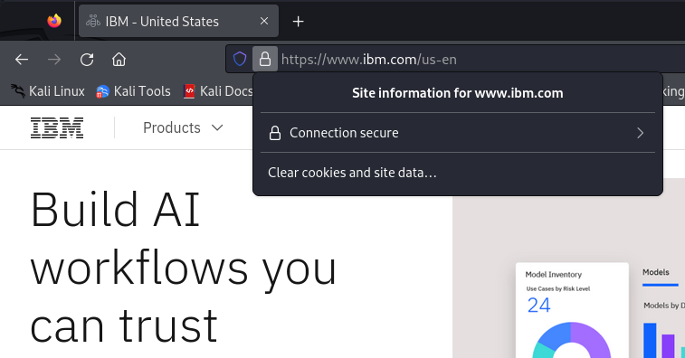
Digital Certificates and Signature
Examining details of a Certificate
Browse to ibm.com and inspect the certificate details (from Firefox, in your Kali-linux Virtual Machine)
Click on the padlock icon in the URL bar.
Click on the arrow to the right of the domain name

Slide 13
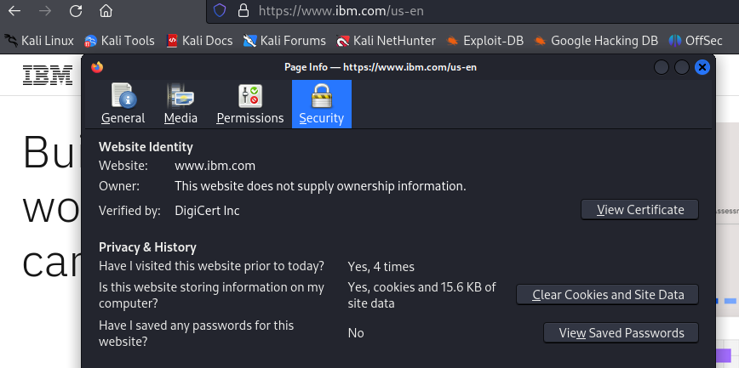
Digital Certificates and Signature
Examining details of a Certificate
Click on “More Information”
Click “View Certificate”

Slide 14
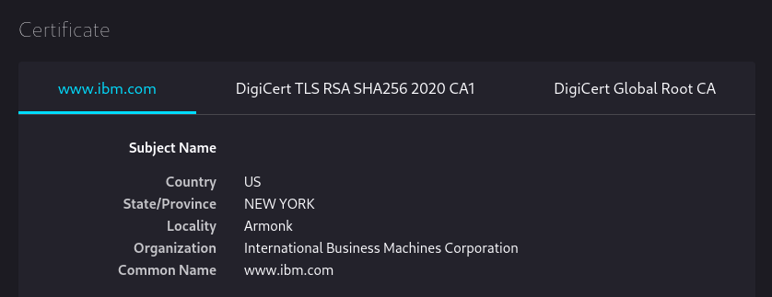
Digital Certificates and Signature
Question 1:
What is the root certificate authority for ibm.com?
Question 2:
What is the intermediate certificate authority?

Slide 15
Digital Certificates and Signature
Question 3:
What are some of the other domains for which this certificate is valid?
Question 4:
What algorithm does IBM’s certificate use for their public key?
Question 5:
What is the keysize of IBM’s public key?

Slide 16
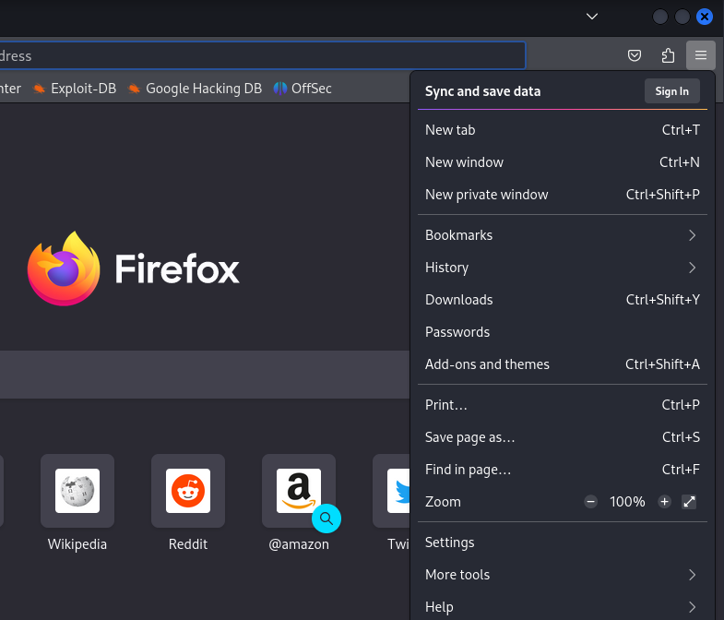
Digital Certificates and Signature
Root Certificate Authorities
In your Kali VM, open Firefox.
Click on the “hamburger” icon in the top-right, and select “Settings”.

Slide 17
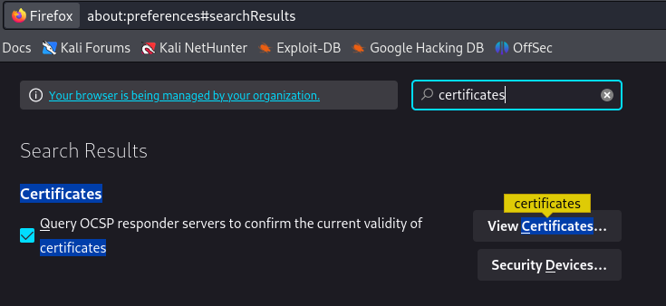
Digital Certificates and Signature
Root Certificate Authorities
Use the settings/preferences search bar to find the “View Certificates” button. Click it.

Slide 18
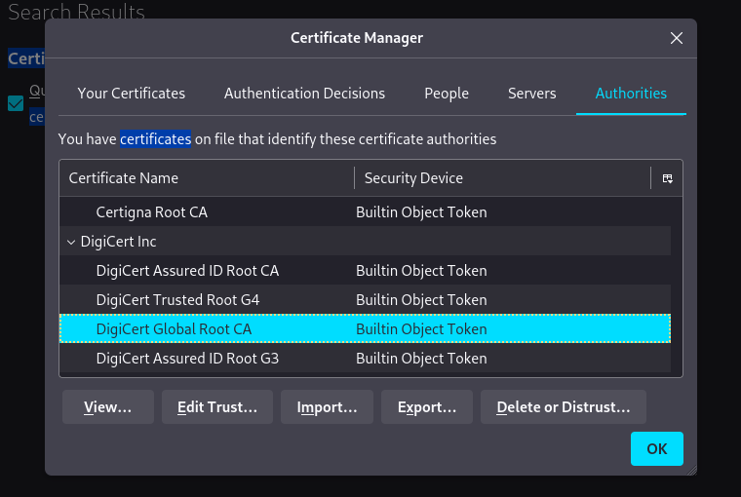
Digital Certificates and Signature
Root Certificate Authorities
Under the ‘Authorities’ tab, find the “DigiCert Global Root CA” certificate that was ultimately used to verify the authenticity of IBM’s certificate. Click “Edit Trust.”

Slide 19
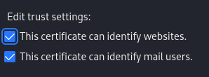
Digital Certificates and Signature
Question 6:
What can this DigiCert root certificate be used for?

Slide 20
Digital Certificates and Signature
Now find any of the root certificates for Symantec Corporation. Select one and click “Edit Trust.”
Question 7:
What can this Symantec root certificate be used for? What can it not be used for?
Examine other certs in the list to see what a “normal” cert in Firefox’s store can do.

Slide 21
Digital Certificates and Signature
Why is the trust for Symantec’s cert anomalous?
Dating back to 2015, Symantec had been called out for some minor mis-issuance issues. In 2016, upon investigating further, Google found other evidence of mis-issuance and that Symantec was practicing lax oversight over the regional authorities it was outsourcing validation to in various regions.
Notes:
https://www.thesslstore.com/blog/final-distrust-symantec-ssl-certificates/

Slide 22
Digital Certificates and Signature
Symantec vs Google
Symantec and Google’s headquarters are across the street from each other, which made for some awkward bus rides to work…
Symantec, rightfully, points out that there were a total of 33 mis-issued test certificates and that no real-world harm actually occurred as a result of it.
Google and the other browsers argued that Symantec’s mis-issuance problems were systemic and by extension, they could no longer trust the certificates Symantec CA brands were issuing.

Slide 23
Digital Certificates and Signature
Google and Symantec reached an agreement:
over the Summer of 2017 that Symantec would shift issuance of certificates to a managed CA while it rebuilt its PKI.
In the meantime, Symantec’s roots would be distrusted, which in turn distrusts all of Symantec’s certificates.
That was what facilitated Symantec selling its CA to DigiCert for nearly a billion dollars and a 30% share.

Slide 24

Break Time…
Be back in 10 min

Slide 25
OpenSSL Demo
In this lab session we will implement all the steps of a secure communication protocol between Alice and Bob, with the support of the Certification Authority kaust_ca, using OpenSSL terminal commands.
Goal: Alice needs to send a file to Bob, over an insecure communication channel, ensuring confidentiality and integrity.
Alice and Bob get a certificate from kaust_ca
Alice and Bob exchange their certificates over an insecure communication channel.
After verifying Bob’s certificate using kaust_ca certificates, Alice encrypt the file and generates a signature. Finally, Alice send to Bob the encrypted file and the signature.
Bob opens the file and verifies the signature

Slide 26
OpenSSL Demo
In your Kali Linux VM, create one folder for this demo:
mkdir openSSL_demo
Go to the demo directory with cd openSSL_demo
Then, create inside this folder one more folder for alice, one for bob, and one for kaust_ca

Slide 27
1.a - Alice generates a private key
$ openssl genpkey -algorithm RSA -pkeyopt rsa_keygen_bits:2048 -pkeyopt rsa_keygen_pubexp:3 -out alice/privkey-A.pem
genpkey ➝ generate a private key
algorithm RSA ➝ use the RSA algorithm (can also take “EC” for elliptic-curve)
rsa_keygen_bits:2048 ➝ sets the size of the key to 2048 bits (the default is 1024)
rsa_keygen_pubexp:3 ➝ sets the public exponent e to 3 (default is 65, 537)
out privkey-A.pem ➝ outputs to the file privkey-A.pem

Slide 28
1.b - Alice generates a public key
$ openssl pkey -in alice/privkey-A.pem -pubout -out alice/pubkey-A.pem
pkey ➝ processes public or private keys
-in privkey-A.pem ➝ read the key from filename privkey-A.pem
-pubout ➝ output a public key (by default, a private key is output)
Repeat Steps 1.a and 1.b for bob and the CA

Slide 29
Step 1.c - Alice generates a certificate signing request
$ openssl req -new -key alice/privkey-A.pem -out alice/A-req.csr
req ➝ creates and processes signing requests
-new ➝ generates a new certificate request, will prompt Alice for some information
-key privkey-A.pem ➝ signs the request with Alice’s private key
Important: you must fill (at least) the “common name” field! It can be a random string, but it must be unique (the Alice's one is different from Bob's one)
Repeat this step for bob

Slide 30
Aside: generating a self-signed certificate for the CA
$ openssl req -x509 -new -nodes -key kaust_ca/privkey-CA.pem -sha256 -days 1024 -out kaust_ca/root.crt
Then, send the certificate to Alice and Bob:
$ cp kaust_ca/root.crt alice
$ cp kaust_ca/root.crt bob

Slide 31
1.d - CA generates and signs a certificate for Alice
$ openssl x509 -req -in alice/A-req.csr -CA kaust_ca/root.crt -CAkey kaust_ca/privkey-CA.pem -CAcreateserial -out alice/A.crt -days 500 -sha256
x509 ➝ an x509 certificate utility (displays, converts, edits and signs x509 certificates)
-req ➝ a certificate request is taken as input (default is a certificate)
-CA root.crt ➝ specifies the CA certificate to be used as the issuer of Alice’s certificate
-CAkey rootkey.pem ➝ specifies the private key used in signing (rootkey.pem)
-CAcreateserial ➝ creates a serial number file which contains a counter for how many certificates were signed by this CA

Slide 32
1.d - CA generates and signs a certificate for Bob
$ openssl x509 -req -in bob/B-req.csr -CA kaust_ca/root.crt -CAkey kaust_ca/privkey-CA.pem -CAcreateserial -out bob/B.crt -days 500 -sha256
Then, Bob sends its certificate to Alice:
$ cp bob/B.crt alice/

Slide 33
Step 2.a - Alice verifies Bob’s public certificate
Repeat the previous steps (1.d) for bob, then send Bob’s certificate to Alice
Alice verifies Bob’s public certificate:
$ openssl verify -CAfile alice/root.crt alice/B.crt
If you get an OK, you know the certificate can be trusted!

Slide 34
Step 2.b - Alice extracts Bob’s public key and Encrypt
$ openssl x509 -pubkey -in alice/B.crt -noout > alice/pubkey-B.pem
Alice creates a file and encrypts it using Bob’s public key
$ echo "This is a private file" > alice/myfile.txt
$ openssl pkeyutl -encrypt -in alice/myfile.txt -pubin -inkey alice/pubkey-B.pem -out alice/myfile.enc

Slide 35
Step 2.c – Additional Security
Alice hashes myfile.txt and encrypts it using her private key
$ openssl dgst -sha1 -sign alice/privkey-A.pem -out alice/signature.bin alice/myfile.txt
Then, Alice sends both the encrypted file and the hash to Bob
$ cp alice/myfile.enc alice/signature.bin bob

Slide 36
Step 3 – File Decryption
Bob decrypts the received file using his private key
$ openssl pkeyutl -decrypt -in bob/myfile.enc
-inkey bob/privkey-B.pem -out bob/myfile.txt
Then, - Bob gets and verifies Alice’s certificate and extracts her public key
Can you do that?
Notes:
$ cp alice/A.crt bob
$ openssl verify -CAfile bob/root.crt bob/A.crt
$ openssl x509 -pubkey -in bob/A.crt -noout > bob/pubkey-A.pem

Slide 37
Step 3.a – File Decryption
Finally, Bob verifies whether the message is coming from Alice
$ openssl dgst -sha1 -verify bob/pubkey-A.pem -signature bob/signature.bin bob/myfile.txt
If you get an OK, the communication protocol is successful !!

Slide 38

Do you have any questions?

